Slide 1

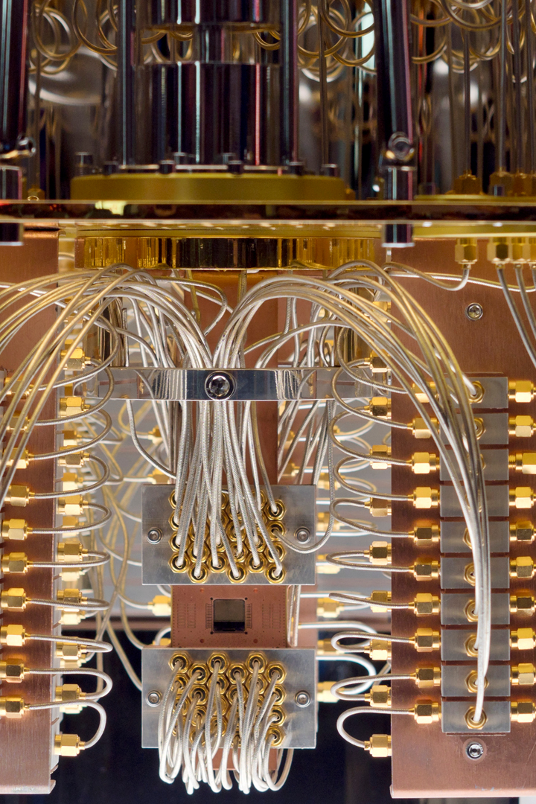
Enhancing Qubit Mapping Efficiency through Machine Learning
This proposal introduces a novel approach that leverages machine learning techniques to predict time optimal qubit mappings based on gate interactions and entanglement patterns within quantum circuits.
By Niyati Jain

Slide 2

Introduction
Understanding Quantum Circuits and Components
Quantum circuits serve as the foundational structures for quantum computing operations.
Quantum gates, integral to these circuits, perform manipulations on qubits, offering parallel processing capabilities.
Significance of Qubit Mapping Efficiency in Quantum Computing
Qubit mapping involves assigning qubits to distinct gates within a quantum circuit.
The efficiency of qubit mapping directly influences the speed of executing quantum gates.
Achieving an optimal qubit mapping is essential for maximizing quantum computing potential, minimizing computation time, and optimizing resource utilization.

Slide 3

Objective
The primary objective is to develop a machine learning model capable of analyzing quantum circuit characteristics, such as gate interactions and entanglement patterns, to predict optimal qubit mappings.
The model aims to minimize gate execution time and, consequently, enhance the overall efficiency of quantum computations.

Slide 4
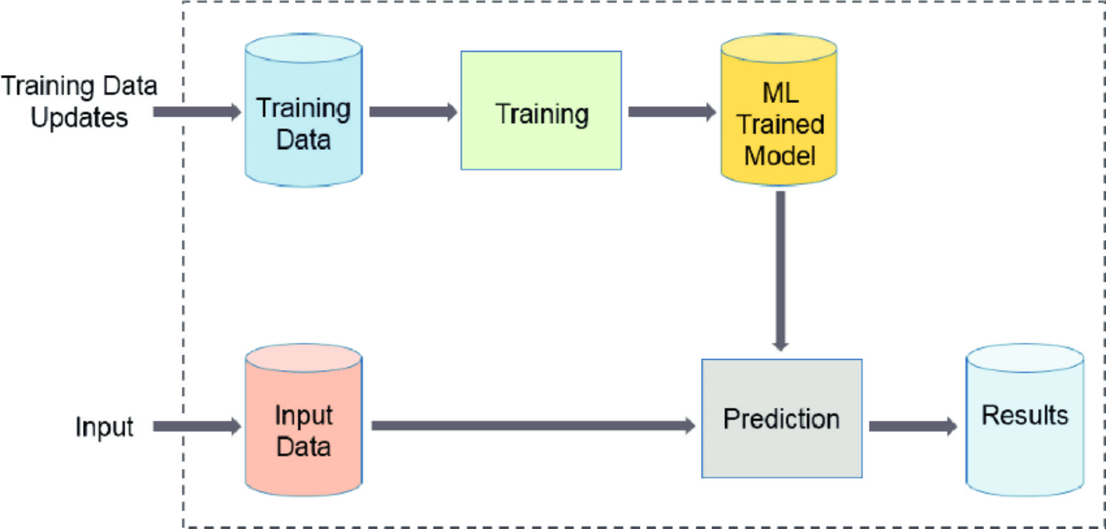
Machine Learning Workflow
Loading...

Slide 5

Methodology
1
Training Data:
A diverse dataset of quantum circuits will be collected, covering various gate sequences and entanglement structures. For each circuit, multiple qubit mappings will be generated, and the corresponding gate execution times will be recorded.
Key Features:
2
These features may include the types of gates used, the distances between entangled qubits, and the overall structural characteristics of the circuit.
3
Target Variable:
The target variable is the gate execution time associated with each qubit mapping.
Machine Learning Algorithm:
4
A regression-based machine learning algorithm will be employed since the goal is to predict a continuous variable (gate execution time)

Slide 6

Trade-offs and Considerations
Computational Complexity Evaluation
Rigorous assessment of the computational complexity during both training and prediction phases.
Balancing model complexity against training time and computational resources required for accurate predictions.
Model Scalability for Increasing Circuit Complexity
Ensuring the proposed approach scales effectively with growing quantum circuit sizes and complexities.
Exploration of techniques such as transfer learning and model adaptation to maintain effectiveness across diverse quantum circuits.

Slide 7

Potential Innovations
Dynamic Circuit Adaptation
Feedback Loop with Quantum Compiler
Real-time Improvement based on Observed Gate Execution Times
Ensemble Learning
Combining Predictions from Multiple Models
Enhancing Robustness and Generalization

Slide 8

Expected Outcomes
Improved efficiency in quantum computations by reducing gate execution times.
Enhanced adaptability to diverse quantum circuit characteristics.
Insights into dynamic circuit adaptation and ensemble learning for qubit mapping optimization.

Slide 9

Conclusion
This proposal outlines a comprehensive approach to integrate machine learning techniques for optimizing qubit mappings based on specific circuit characteristics.
The proposed methodology aims to contribute to the efficiency of quantum computations, bringing us closer to unlocking the full potential of quantum computing.

Slide 10
Thank you

